Slide 1
Fundamentals of Python: First Programs Second Edition
Chapter 7
Simple Graphics and Image Processing

Slide 2
Objectives (1 of 2)
7.1 Use the concepts of object-based programming—classes, objects, and methods—to solve a problem
7.2 Develop algorithms that use simple graphics operations to draw two-dimensional shapes
7.3 Use the R G B system to create colors in graphics applications and modify pixels in images

Slide 3
Objectives (2 of 2)
7.4 Develop recursive algorithms to draw recursive shapes
7.5 Write a nested loop to process a two-dimensional grid
7.6 Develop algorithms to perform simple transformations of images, such as conversion of color to grayscale

Slide 4
Simple Graphics
Graphics: Discipline that underlies the representation and display of geometric shapes in two- and three-dimensional space
A Turtle graphics toolkit provides a simple and enjoyable way to draw pictures in a window
turtle is a non-standard, open-source Python module

Slide 5
Overview of Turtle Graphics (1 of 2)
Turtle graphics originally developed as part of the children’s programming language Logo
Created by Seymour Papert and his colleagues at M I T in the late 1960s
Analogy: Turtle crawling on a piece of paper, with a pen tied to its tail
Sheet of paper is a window on a display screen
Position specified with (x, y) coordinates
Cartesian coordinate system, with origin (0, 0) at the center of a window

Slide 6
Overview of Turtle Graphics (2 of 2)
Table 7-1 Some attributes of a turtle
Heading | Specified in degrees, the heading or direction increases in value as the turtle turns to the left, or counterclockwise. Conversely, a negative quantity of degrees indicates a right, or clockwise, turn. the turtle is initially facing east, or 0 degrees. North is 90 degrees, West is 180 degrees, and South is 270 degrees.
Color | Initially black, the color can be changed to any of more than 16 million other colors.
Width | This is the width of the line drawn when the turtle moves. The initial width is 1 pixel. (You'll learn more about pixels shortly)
Down | This attribute, which can be either true or false, controls whether the turtle's pen is up or down. When true (that is, when the pen is down), the turtle draws a line when it moves. When false (that is, when the pen is up), the turtle can move without drawing a line.

Slide 7
Turtle Operations (1 of 3)
Turtle Method | What It Does
t = Turtle () | Creates a new Turtle object and opens its window
t.home() | Moves t to the center of the window and then points t east
t.up() | Raises t’s pen from the drawing surface
t.down() | Lowers t’s pen to the drawing surface
t.setheading(degrees) | Points t in the indicated direction, which is specified in degrees
t.left(degrees) t.right(degrees) | Rotates t to the left or the right by the specified degrees
t.goto(x, y) | Moves t to the specified position
t.forward(distance) | Moves t to the specified distance in the current direction
t.pencolor(r, g, b) t.pencolor(string) | Changes the pen color of t to the specified RGB value or to the specified string
t.fillcolor(r, g, b) t.fillcolor(string) | Changes the fill color of t to the specified RBG value or to the specified string

Slide 8
Turtle Operations (2 of 3)
Turtle Method | What It Does
t.begin_fill() t.end_fill() | Enclose a set of turtle commands that will draw a filled shape using the current fill color
t.clear() | Erases all of the turtle’s drawings, without changing the turtle’s state
t.width(pixels) | Changes the width of t to the specified number of pixels
t.hideturtle() t.showturtle() | Makes the turtle invisible or visible
t.position() | Returns the current position (x, y) of t
t.heading() | Returns the current direction of t
t.isdown() | Returns True if t’s pen is down or False otherwise
t.circle(radius) | Draws a circle with the given radius
Overview of turtle methods at https://docs.python.org/3/library/turtle.html

Slide 9
Turtle Operations (3 of 3)
Interface: set of methods of a given class
Used to interact with an object
Use docstring mechanism to view an interface
help(<class name>)
help(<class name>.<method name>)
def drawSquare(t, x, y, length):
"""Draws a square with the given turtle t, an upper-left
corner point (x, y), and a side's length."""
t.up()
t.goto(x, y)
t.setheading(270)
t.down()
for count in range(4):
t.forward(length)
t.left(90)

Slide 10
Setting Up a turtle.cfg File and Running I D L E
Turtle graphics configuration file (turtle.cfg)
Contains initial settings of several attributes of Turtle, Screen, and Canvas objects
Python creates default settings for these attributes
The attributes in the file used for most of out examples are:
width = 300
height = 200
using_I D L E = True
colormode = 255
To create a file with these settings:
Open a text editor, enter the settings, and save the file as turtle.cfg

Slide 11
Object Instantiation and the Turtle Module (1 of 3)
Turtle is a class – a set of variables and methods that can be used for a turtle. You can create objects from a class.
Before you can use any of the methods with our object (ted), you must create the object (i.e., an instance of). This is called instantiation.
<variable name> = <class name>(<any arguments>) Example: ted = Turtle() #instantiating the object named ted
The Turtle class has a constructor, which is a special type of method that goes through the steps to instantiate an object. It is hidden in the Turtle library with all the other Turtle methods.
We also have to import the Turtle class at the top of our program:
from turtle import Turtle

Slide 12
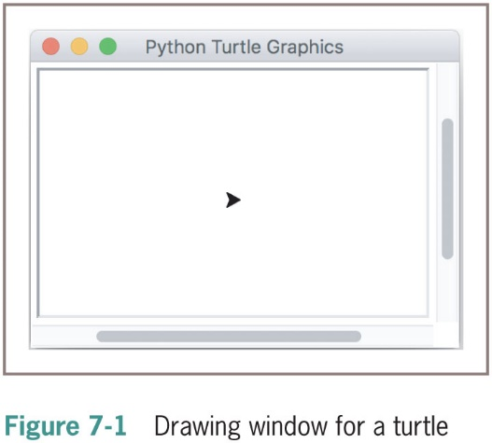
Object Instantiation and the Turtle Module (2 of 3)
To close a turtle’s window, click its close box
Attempting to manipulate a turtle whose window has been closed raises an error

Slide 13
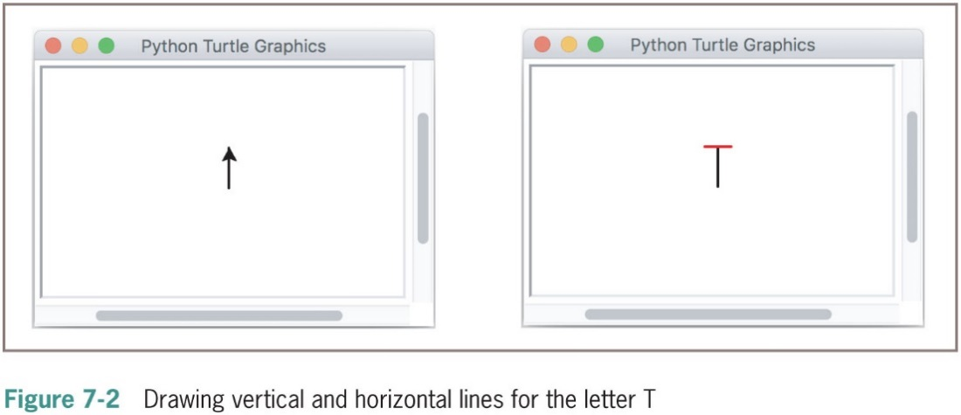
Object Instantiation and the Turtle Module (3 of 3)
Once you have created your turtle object, you can call his methods and variables.
ted.width(2) # For bolder lines
ted.left(90) # Turn to face north
ted.forward(30) # Draw a vertical line in black
ted.left(90) # Turn to face west
ted.up() # Prepare to move without drawing
ted.forward(10) # Move to beginning of horizontal line
ted.setheading(0) # Turn to face east
ted.pencolor("red")
ted.down() # Prepare to draw
ted.forward(20) # Draw a horizontal line in red
ted.hideturtle() # Make the turtle invisible

Slide 14
Drawing Two-Dimensional Shapes (1 of 3)
Many graphics applications use vector graphics, or the drawing of simple two-dimensional shapes, such as rectangles, triangles, and circles
Example code:
def square(t, length):
"""Draws a square with the given length."""
for count in range(4):
t.forward(length)
t.left(90)
def drawShape(turtle, sides, len):
""" Draws a shape with the given number of sides and side length """
for i in range(sides):
turtle.forward(len)
turtle.right(360 / sides)

Slide 15
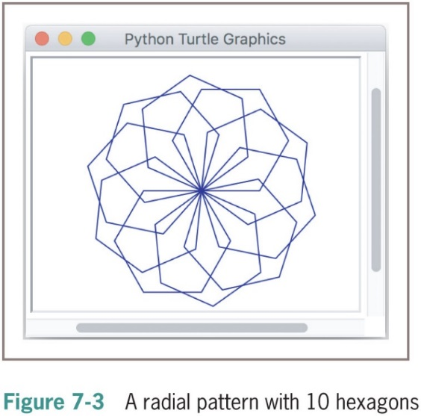
Drawing Two-Dimensional Shapes (2 of 3)
The code for a function to draw a pattern named radialHexagons, expects a turtle, the number of hexagons, and the length of a side as arguments:
def radial Hexagons(t, n, length):
"""Draws a radial pattern of n hexagons with the given length."""
for count in range(n):
drawShape(t, 6, length)
t.left(360 / n)

Slide 16
Drawing Two-Dimensional Shapes (3 of 3)
The code for drawing a radial pattern using any regular polygon followed by a session using it with squares and hexagons:
def radialpattern(t, n, length, nbrSides):
"""Draws a radial pattern of n shapes with the given length."""
for count in range(n):
drawShape(t, nbrSides, length)
t.left(360 / n)
>>> t = Turtle()
>>> radialpattern(t, n = 10, length = 50, nbrSides = 4)
>>> t.clear()
>>> radialpattern(t, n = 10, length = 50, nbrSides = 6)

Slide 17
Examining an Object’s Attributes
Mutator methods - methods that change the internal state of a Turtle object
Accessor methods – methods that return the values of a Turtle object’s attributes without altering its state
Code that shows accessor methods in action:
>>> from turtle import Turtle
>>> t = Turtle()
>>> t.position()
(0.0, 0.0)
>>> t.heading()
0.0
>>> t.is down()
True

Slide 18
Manipulating a Turtle’s Screen
Access a turtle’s Screen object using the notation t.screen
Then call a Screen method with this object
Methods window_width() and window_height() can be used to locate the boundaries of a turtle’s window
Code that resets the screen’s background color:
>>> from turtle import Turtle
>>> t = Turtle()
>>> t.screen.bgcolor("orange")
>>> x = t.screen.window_width() // 2
>>> y = t.screen.window_height() // 2
>>> print((−x, y), (x, −y))

Slide 19
Taking a Random Walk (1 of 2)
from turtle import Turtle
import random
def main():
t = Turtle()
t.shape(“turtle”)
randomWalk(t, 40, 30)
def randomWalk(t, turns, distance = 20):
"""Turns a random number of degrees and moves a given
distance for a fixed number of turns."""
for x in range(turns):
if x % 2 == 0:
t.left(random.randint(0, 270))
else:
t.right(random.randint(0, 270))
t.forward(distance)
if __name__ == “__main__”:
main()

Slide 20
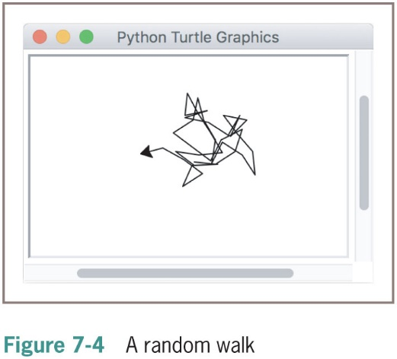
Taking a Random Walk (2 of 2)

Slide 21
Colors and the R G B System (1 of 2)
Display area on a computer screen is made up of colored dots called picture elements or pixels
Each pixel represents a color – the default is black
Change the color by running the pencolor method
R G B is a common system for representing colors
R G B stands for red, green, and blue
Each color component can range from 0 – 255
255 → maximum saturation of a color component
0 → total absence of that color component
A true color system

Slide 22
Colors and the R G B System (2 of 2)
Each color component requires 8 bits; total number of bits needed to represent a color value is 24
Total number of RGB colors is
Color | R G B Value
Black | (0, 0, 0)
Red | (255, 0, 0)
Green | (0, 255, 0)
Blue | (0, 0, 255)
Yellow | (255, 255, 0)
Gray | (127, 127, 127)
White | (255, 255, 255)

Slide 23
Turtle Speed
The turtle’s speed is a value between 1 and 10
If a speed outside the range 1-10 is given, the speed will be set to 0
The speed values work as follows:
‘fastest’ : 0
‘fast’ : 10
‘normal’ : 6
‘slow’ : 3
‘slowest’ : 1
The speed set controls how fast the turtle draws the shapes
Example:
t = Turtle()
t.speed(0) # sets the turtle to the fastest speed

Slide 24
Example: Filling Radial Patterns with Random Colors (1 of 5)
The Turtle class includes a pencolor method for changing the turtle’s drawing color
Expects integers for the three R G B components
Script that draws radial patterns of squares and hexagons with random fill colors at the corners of turtle’s window (output is shown in Figure 7-5):
"""
File: randompatterns.py
Draws a radial pattern of squares in a random fill color
at each corner of the window.
"""
from turtle import Turtle
from polygons import *
import random

Slide 25
Example: Filling Radial Patterns with Random Colors (2 of 5)
def drawPattern(t, x, y, count, length, shape):
"""Draws a radial pattern with a random
fill color at the given position."""
t.begin_fill()
t.up()
t.goto(x, y)
t.setheading(0)
t.down()
t.fillcolor(random.randint(0, 255),
random.randint(0, 255),
random.randint(0, 255))
radialpattern(t, count, length, shape)
t.end_fill()

Slide 26
Example: Filling Radial Patterns with Random Colors (3 of 5)
def main():
t = Turtle()
t.speed(0)
# Number of shapes in radial pattern
count = 10
# Relative distances to corners of window from center
width = t.screen.window_width() // 2
height = t.screen.window_height() // 2
# Length of the square
length = 30
# Inset distance from window boundary for squares
inset = length * 2
# Draw squares in upper-left corner
drawPattern(t, - width + inset, height - inset, count,
length, square)

Slide 27
Example: Filling Radial Patterns with Random Colors (4 of 5)
# Draw squares in lower-left corner
drawPattern(t, −width + inset, inset − height, count,
length, square)
# Length of the hexagon
length = 20
# Inset distance from window boundary for hexagons
inset = length * 3
# Draw hexagons in upper−right corner
drawPattern(t, width - inset, height − inset, count,
length, hexagon)
# Draw hexagons in lower−right corner
drawPattern(t, width − inset, inset − height, count,
length, hexagon)
if _name_== “_main_”:
main()

Slide 28
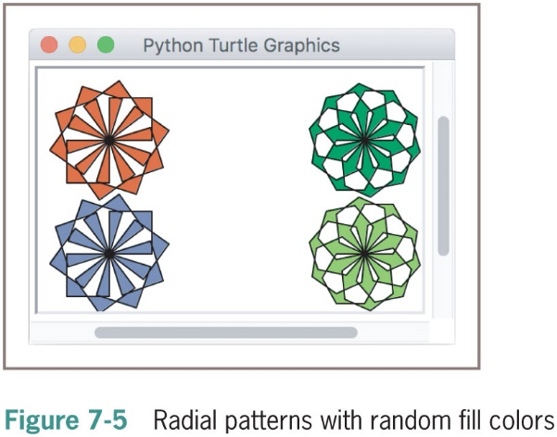
Example: Filling Radial Patterns with Random Colors (5 of 5)

Slide 29
Image Processing
Digital image processing includes the principles and techniques for the following:
The capture of images with devices such as flatbed scanners and digital cameras
The representation and storage of images in efficient file formats
Constructing the algorithms in image-manipulation programs such as Adobe Photoshop

Slide 30
Analog and Digital Information
Computers must use digital information which consists of discrete values
Example: Individual integers, characters of text, or bits
The information contained in images, sound, and much of the rest of the physical world is analog
Analog information contains a continuous range of values
Ticks representing seconds on an analog clock’s face represent an attempt to sample moments of time as discrete values (time itself is analog)

Slide 31
Sampling and Digitizing Images
A visual scene projects an infinite set of color and intensity values onto a two-dimensional sensing medium
If you sample enough of these values, digital information can represent an image more or less indistinguishable (to human eye) from original scene
Sampling devices measure discrete color values at distinct points on a two-dimensional grid
These values are pixels
As more pixels are sampled, the more realistic the resulting image will appear

Slide 32
Image File Formats
Once an image has been sampled, it can be stored in one of many file formats
A raw image file saves all of the sampled information
Data can be compressed to minimize its file size
JPEG (Joint Photographic Experts Group)
Uses lossless compression and a lossy scheme
GIF (Graphic Interchange Format)
Uses a lossy compression and a color palette of up to 256 of the most prevalent colors in the image

Slide 33
Image-Manipulation Operations
Image-manipulation programs either transform the information in the pixels or alter the arrangement of the pixels in the image
Examples:
Rotate an image
Convert an image from color to grayscale
Apply color filtering to an image
Highlight a particular area in an image
Blur all or part of an image
Sharpen all or part of an image
Control the brightness of an image
Perform edge detection on an image
Enlarge or reduce an image’s size
Apply color inversion to an image
Morph an image into another image

Slide 34
The Properties of Images
The coordinates of pixels in the two-dimensional grid of an image range from (0, 0) at the upper-left corner to (width−1, height−1) at lower-right corner
width/height are the image’s dimensions in pixels
Thus, the screen coordinate system for the display of an image is different from the standard Cartesian coordinate system that we used with Turtle graphics
The R G B color system is a common way of representing the colors in images

Slide 35
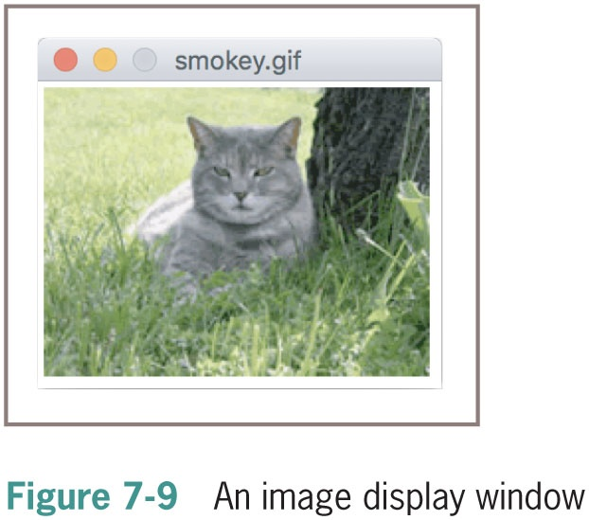
The images Module (1 of 5)
The images module is a non-standard, open-source Python tool
Image class represents an image as a two-dimensional grid of R G B values
The following session with the interpreter does the following:
Imports the Image class from the images module
Instantiates this class using the file named smokey.gif
Draws the image
>>> from images import Image
>>> image = Image("smokey.g i f")
>>> image.draw()

Slide 36
The images Module (2 of 5)
Once an image has been created, you can examine its width and height, as follows:
>>> image.getWidth()
198
>>> image.getHeight()
149
Alternatively, you can print the image’s string representation:
>>> print(image)
Filename: smokey.g i f
Width: 198
Height: 149

Slide 37
The images Module (3 of 5)
The method getPixel returns a tuple of the R G B values at the given coordinates
The following session shows the information for the pixel at position (0,0):
>>> image.getPixel(0, 0)
(194, 221, 114)
The programmer can use the method setPixel to replace an R G B value at a given position in an image:
>>> image = Image(500, 500)
>>> image.draw()
>>> blue = (0, 0, 255)
>>> y = image.getHeight() // 2
>>> for x in range(image.getWidth()):
image.setPixel(x, y - 1, blue)
image.setPixel(x, y, blue)
image.setPixel(x, y + 1, blue)
>>> image.draw()

Slide 38
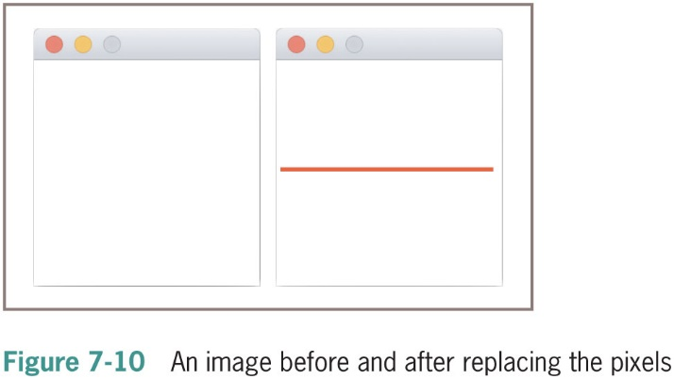
The images Module (4 of 5)

Slide 39
The images Module (5 of 5)
Use the save operation to write an image back to an existing file using the current filename
The following code saves the new image using the filename horizontal.g i f:
>>> image.save("horizontal.g i f")

Slide 40
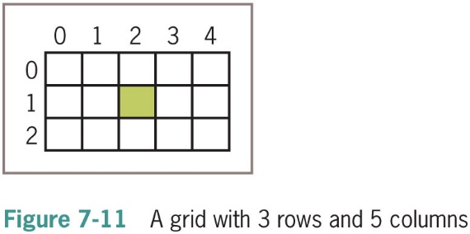
A Loop Pattern for Traversing a Grid (1 of 2)
Most of the loops we have used in this book have had a linear loop structure
Many image-processing algorithms use a nested loop structure to traverse a two-dimensional grid of pixels

Slide 41
A Loop Pattern for Traversing a Grid (2 of 2)
The following loop uses a row-major traversal
>>> width = 2
>>> height = 3
>>> for y in range(height):
for x in range(width):
print((x, y), end = " ")
print()
(0, 0) (1, 0)
(0, 1) (1, 1)
(0, 2) (1, 2)
We use this template to develop many of the algorithms that follow:
for y in range(height):
for x in range(width):
<do something at position (x, y)>

Slide 42
A Word on Tuples
A pixel’s R G B values are stored in a tuple:
>>> image = Image("smokey.g i f")
>>> (r, g, b) = image.getPixel(0, 0)
>>> r
194
>>> g
221
>>> b
114
>>> image.setPixel(0, 0, (r + 10, g + 10, b + 10))

Slide 43
Converting an Image to Black and White (1 of 2)
For each pixel, compute average of R/G/B values
Then, reset pixel’s color values to 0 (black) if the average is closer to 0, or to 255 (white) if the average is closer to 255
def blackAndWhite(image):
"""Converts the argument image to black and white."""
blackPixel = (0, 0, 0)
whitePixel = (255, 255, 255)
for y in range(image.getHeight()):
for x in range(image.getWidth()):
(r, g, b) = image.getPixel(x, y)
average = (r + g + b) // 3
if average < 128:
image.setPixel(x, y, blackPixel)
else:
image.setPixel(x, y, whitePixel)

Slide 44
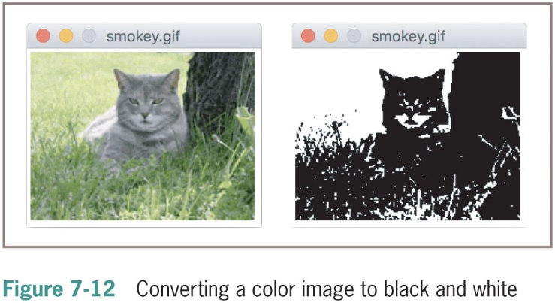
Converting an Image to Black and White (2 of 2)

Slide 45
Converting an Image to Grayscale (1 of 3)
Black and white photographs contain various shades of gray known as grayscale
Grayscale can be an economical scheme (the only color values might be 8, 16, or 256 shades of gray)
A simple method:
average = (r + g + b) // 3
image.setPixel(x, y, (average, average, average)
Problem: Does not reflect manner in which different color components affect human perception
Scheme needs to take differences in luminance into account

Slide 46
Converting an Image to Grayscale (2 of 3)
def grayscale(image):
"""Converts the argument image to grayscale."""
for y in range(image.getHeight()):
for x in range(image.getWidth()):
(r, g, b) = image.getPixel(x, y)
r = int(r * 0.299)
g = int(g * 0.587)
b = int(b * 0.114)
lum = r + g + b
image.setPixel(x, y, (lum, lum, lum))

Slide 47
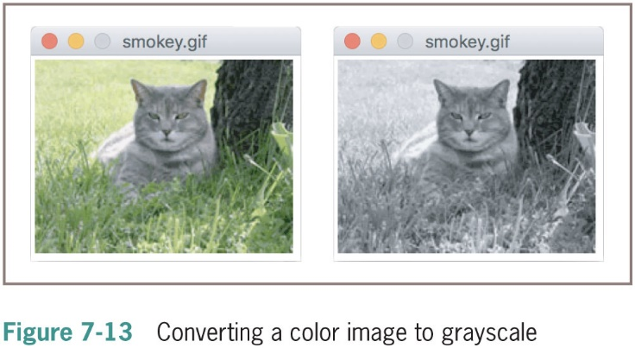
Converting an Image to Grayscale (3 of 3)

Slide 48
Copying an Image
The method clone builds and returns a new image with the same attributes as the original one, but with an empty string as the filename
>>> from images import Image
>>> image = Image("smokey.gif")
>>> image.draw()
>>> newImage = image.clone() # Create a copy of image
>>> newImage.draw()
>>> grayscale(newImage) # Change in second window only
>>> newImage.draw()
>>> image.draw() # Verify no change to original

Slide 49
Blurring an Image
Pixilation can be mitigated by blurring
def blur(image):
"""Builds and returns a new image which is a
blurred copy of the argument image."""
def tripleSum(triple1, triple2):
#1
(r1, g1, b1) = triple1
(r2, g2, b2) = triple2
return (r1 + r2, g1 + g2, b1 + b2)
new = image.clone()
for y in range(1, image.getHeight() - 1):
for x in range(1, image.getWidth() - 1):
old P = image.getPixel(x, y)
left = image.getPixel(x - 1, y) # To left
right = image.getPixel(x + 1, y) # To right
top = image.getPixel(x, y - 1) # Above
bottom = image.getPixel(x, y + 1) # Below
sums = reduce(tripleSum,
[oldP, left, right, top, bottom])
#2
averages = tuple(map(lambda x: x // 5, sums))
#3
new.setPixel(x, y, averages)
return new

Slide 50
Edge Detection (1 of 3)
Edge detection removes the full colors to uncover the outlines of the objects represented in the image
def detectEdges(image, amount):
"""Builds and returns a new image in which the edges of
the argument image are highlighted and the colors are
reduced to black and white."""
def average(triple):
(r, g, b) = triple
return (r + g + b) // 3
blackPixel = (0, 0, 0)
whitePixel = (255, 255, 255)
new = image.clone()

Slide 51
Edge Detection (2 of 3)
Edge detection (continued)
for y in range(image.getHeight() − 1):
for x in range(1, image.getWidth()):
oldPixel = image.getPixel(x, y)
leftPixel = image.getPixel(x − 1, y)
bottomPixel = image.getPixel(x, y + 1)
old Lum = average(oldPixel)
left Lum = average(leftPixel)
bottom Lum = average(bottomPixel)
if abs(oldLum − leftLum) > amount or \
abs(oldLum − bottomLum) > amount:
new.setPixel(x, y, blackPixel)
else:
new.setPixel(x, y, whitePixel)
return new

Slide 52
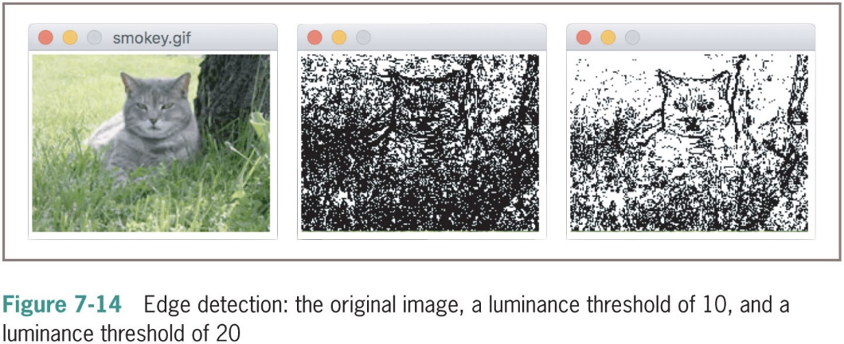
Edge Detection (3 of 3)

Slide 53
Reducing the Image Size (1 of 2)
The size and the quality of an image on a display medium depend on two factors:
Image’s width and height in pixels
Display medium’s resolution
Measured in pixels, or dots per inch (D P I)
The resolution of an image can be set before the image is captured
A higher D P I causes sampling device to take more samples (pixels) through the two-dimensional grid
A size reduction usually preserves an image’s aspect ratio
Reducing an image’s size throws away some of its pixel information

Slide 54
Reducing the Image Size (2 of 2)
def shrink(image, factor):
"""Builds and returns a new image which is a smaller
copy of the argument image, by the factor argument."""
width = image.getWidth()
height = image.getHeight()
new = Image(width // factor, height // factor)
oldY = 0
newY = 0
while oldY < height - factor:
oldX = 0
newX = 0
while oldX < width - factor:
oldP = image.getPixel(oldX, oldY)
new.setPixel(newX, newY, oldP)
oldX += factor
newX += 1
oldY += factor
newY += 1
return new

Slide 55
Chapter Summary (1 of 3)
Object-based programming uses classes, objects, and methods to solve problems
A class specifies a set of attributes and methods for the objects of that class
The values of the attributes of a given object make up its state
A new object is obtained by instantiating its class
The behavior of an object depends on its current state and on the methods that manipulate this state
The set of a class’s methods is called its interface

Slide 56
Chapter Summary (2 of 3)
Turtle graphics is a lightweight toolkit used to draw pictures in a Cartesian coordinate system
RGB system represents a color value by mixing integer components that represent red, green, and blue intensities
A grayscale system uses 8, 16, or 256 distinct shades of gray
Digital images are captured by sampling analog information from a light source, using a device such as a digital camera or a flatbed scanner
Can be stored in several formats, like J P E G and G I F

Slide 57
Chapter Summary (3 of 3)
When displaying an image file, each color value is mapped onto a pixel in a two-dimensional grid
A nested loop structure is used to visit each position
Image-manipulation algorithms either transform pixels at given positions or create a new image using the pixel information of a source image

